Slide 1
8086 Stack, Procedures
Md. Shahidul Salim
Farhan Sadaf

Slide 2
Stack
The 8086 microprocessor has a dedicated area in memory called the stack, which is used for temporary storage of data during program execution.
It operates on a Last-In-First-Out (LIFO) principle, meaning that the most recently stored data is the first to be retrieved.
The stack pointer (SP) is a 16-bit register that points to the current top of the stack. It contains the offset address of the memory location in the stack segment.
Stack Segment (SS) register contains the base address of the stack segment in the memory.
The stack segment, like any other segment, may have a memory block of a maximum of 64 Kbytes locations, and thus may overlap with any other segments.

Slide 3

Stack (Cont.)
The Stack Segment register (SS) and Stack pointer register (SP) together address the stack-top.
For a selected value of SS, the maximum value of SP=FFFFH and the segment can have maximum of 64K locations.
If the SP starts with an initial value of FFFFH, it will be decremented by two whenever a 16-bit data is pushed onto the stack.
After successive push operations, when the stack pointer contains 0000H, any attempt to further push the data to the stack will result in stack overflow.

Slide 4
Stack (Cont.)
Stack is used by CALL instruction to keep return address for procedure, RET instruction gets this value from the stack and returns to that offset.
Quite the same thing happens when INT instruction calls an interrupt, it stores in stack flag register, code segment and offset.
IRET instruction is used to return from interrupt call.

Slide 5
Stack Operations
PUSH
Stores a 16 bit value in the stack. Stack pointer (SP) is decremented by 2, for every PUSH operation.
E.g. PUSH AX means SP=SP-2 and AX->[SP].
Syntax for PUSH instruction:
PUSH REG
PUSH SREG
PUSH memory
PUSH immediate (Only works on 80186 CPU and later)
REG: AX, BX, CX, DX, DI, SI, BP, SP.
SREG: DS, ES, SS, CS.
memory: [BX], [BX+SI+7], 16 bit variable, etc...
immediate: 5, -24, 3Fh, 10001101b, etc...

Slide 6
Stack Operations (Cont.)
POP
Gets 16 bit value from the stack. Stack pointer (SP) is incremented by 2, for every POP operation.
E.g. POP AX means [SP]->AX and SP=SP+2.
Syntax for POP instruction:
POP REG
POP SREG
POP memory
REG: AX, BX, CX, DX, DI, SI, BP, SP.
SREG: DS, ES, SS, (except CS).
memory: [BX], [BX+SI+7], 16 bit variable, etc...

Slide 7
Stack Operations (Cont.)
PUSHF and POPF
These instructions are used to push and pop the flags register (FLAGS) onto and from the stack.
They are often used when preserving and restoring the processor's status during subroutine calls or context switches.

Slide 8
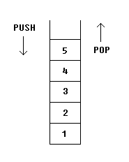
Stack Operations (Cont.)
If we push these values one by one into the stack: 1, 2, 3, 4, 5 the first value that we will get on pop will be 5, then 4, 3, 2, and only then 1.
It is very important to do equal number of PUSHs and POPs, otherwise the stack maybe corrupted and it will be impossible to return to operating system.

Slide 9
Stack Examples
PUSH and POP instruction are especially useful because we don't have too much registers to operate with, so here is a trick:
Store original value of the register in stack (using PUSH).
Use the register for any purpose.
Restore the original value of the register from stack (using POP).
ORG 100h
MOV AX, 1234h
PUSH AX ; store value of AX in stack.
MOV AX, 5678h ; modify the AX value.
POP AX ; restore the original value of AX.
RET
END

Slide 10
Stack Examples (Cont.)
Another use of the stack is for exchanging the values.
ORG 100h
MOV AX, 1212h ; store 1212h in AX.
MOV BX, 3434h ; store 3434h in BX
PUSH AX ; store value of AX in stack.
PUSH BX ; store value of BX in stack.
POP AX ; set AX to original value of BX.
POP BX ; set BX to original value of AX.
RET
END

Slide 11
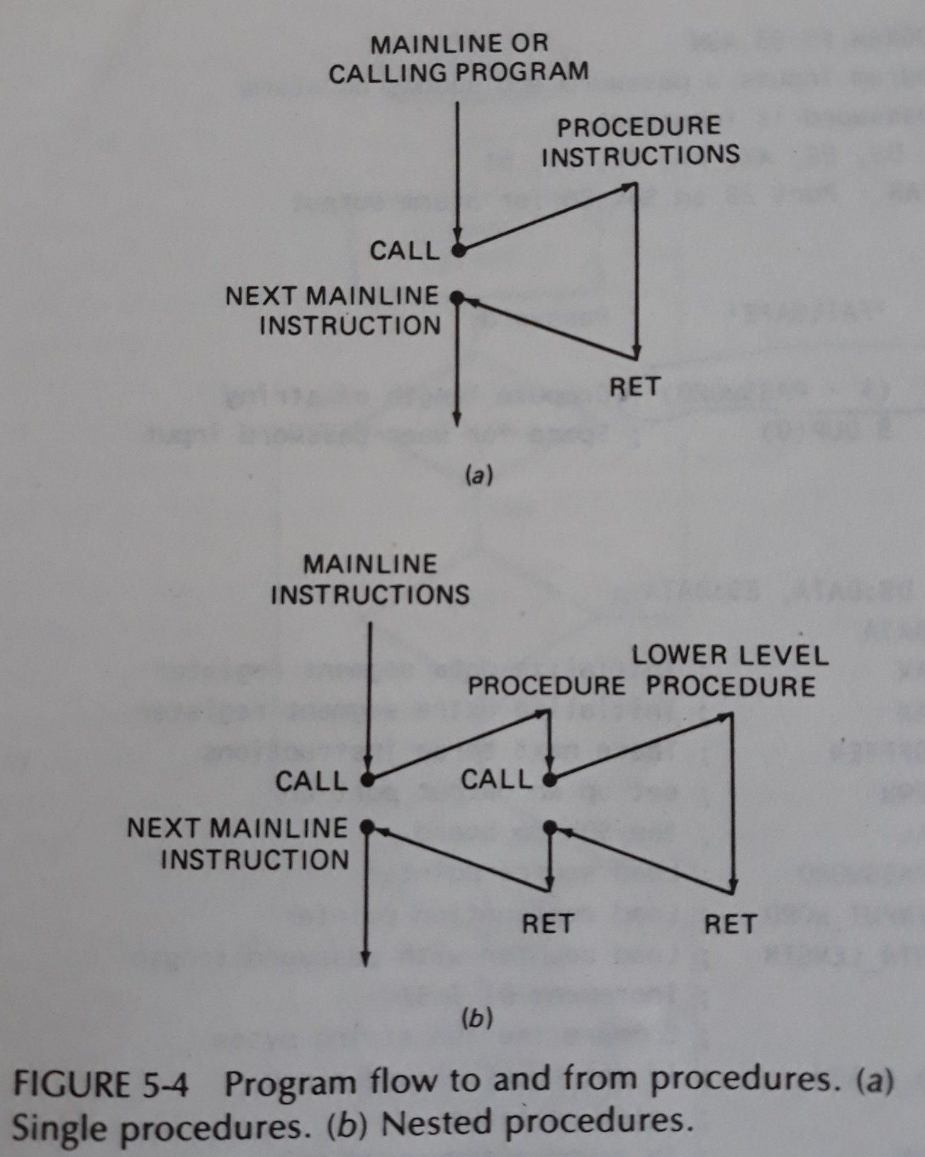
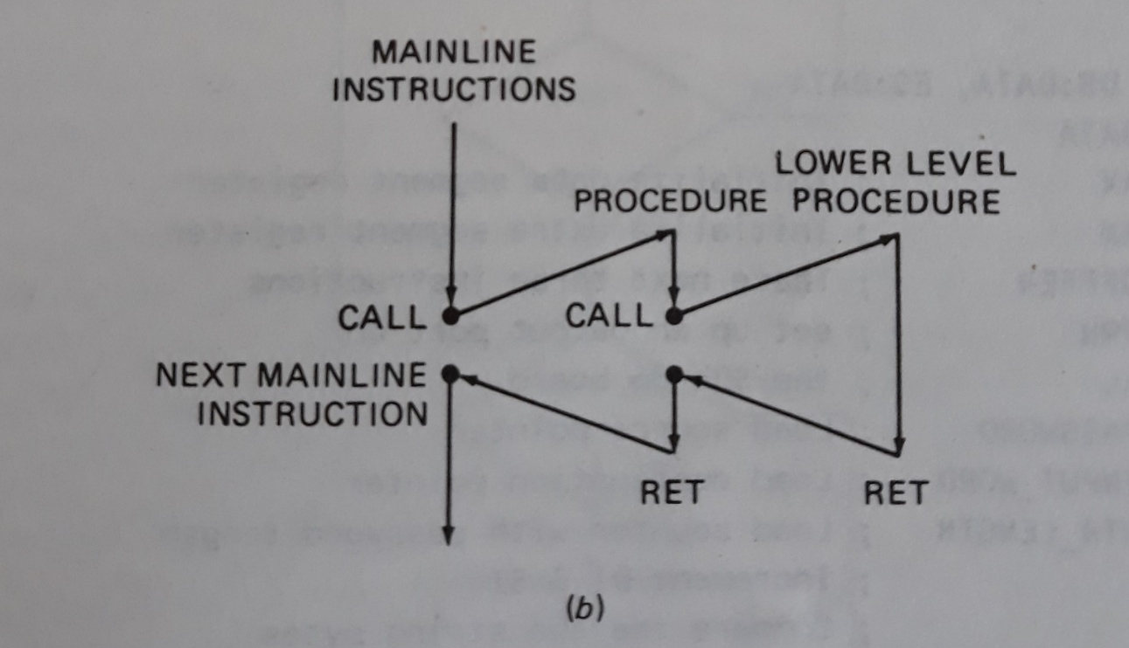
Procedures
In a program, we very frequently face situations where there is a need to perform the same set of task again and again. So, for that instead of writing the same sequence of instructions, again and again, they are written separately in a subprogram. This subprogram is called a procedure.

Slide 12
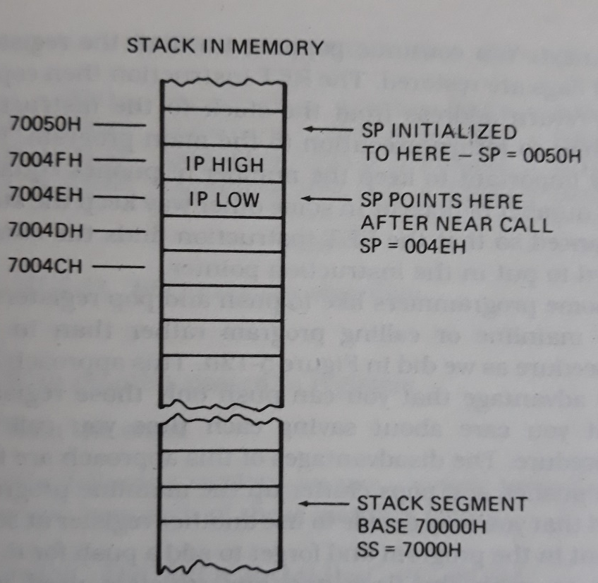
Procedure Types
Near Call or Intra-segment call
A near call refers a procedure which is in the same code segment.
Only Instruction Pointer (IP) contents will be changed in NEAR procedure.
Near calls are more efficient in terms of execution time because they do not involve changing the code segment register.
SP <- SP-2
IP -> stores onto stack
IP <- starting address of a procedure

Slide 13
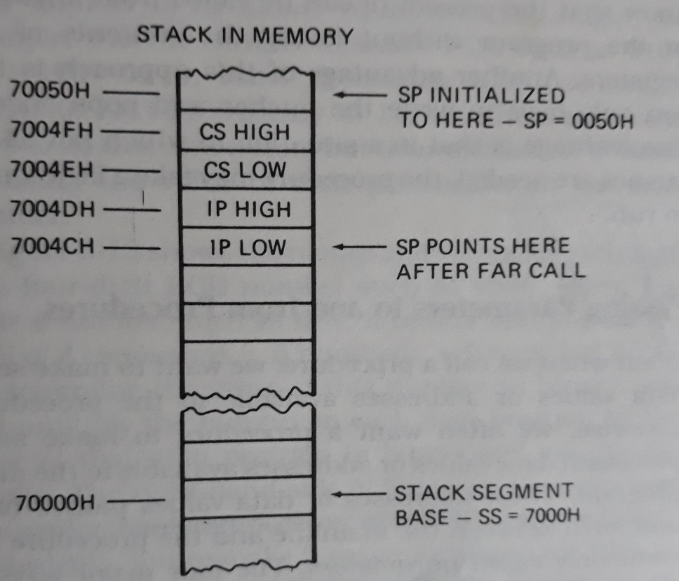
Procedure Types (Cont.)
Far Call or Inter-segment call
A Far call refers a procedure which is in different code segment.
In this case both Instruction Pointer (IP) and the Code Segment (CS) register content will be changed.
SP <- sp-2
cs contents -> stored on stack
SP <- sp-2
IP contents -> stored on stack
CS <- Base address of segment having procedure
IP <- address of first instruction in procedure

Slide 14
Procedure Syntax
PROC is a keyword to define that the set of instructions enclosed by the given name is a procedure.
The ENDP keyword defines that the body of the procedure has been ended.
The procedure will be executed whenever a CALL to the procedure is made.
procedure_name PROC [NEAR / FAR]
Instruction 1
Instruction 2
- - - - - - - - - - -
- - - - - - - - - - -
Instruction n
procedure_name ENDP
CALL procedure_name

Slide 15
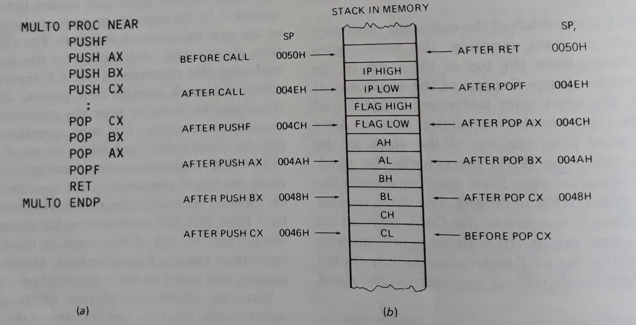
Procedure Examples

Slide 16
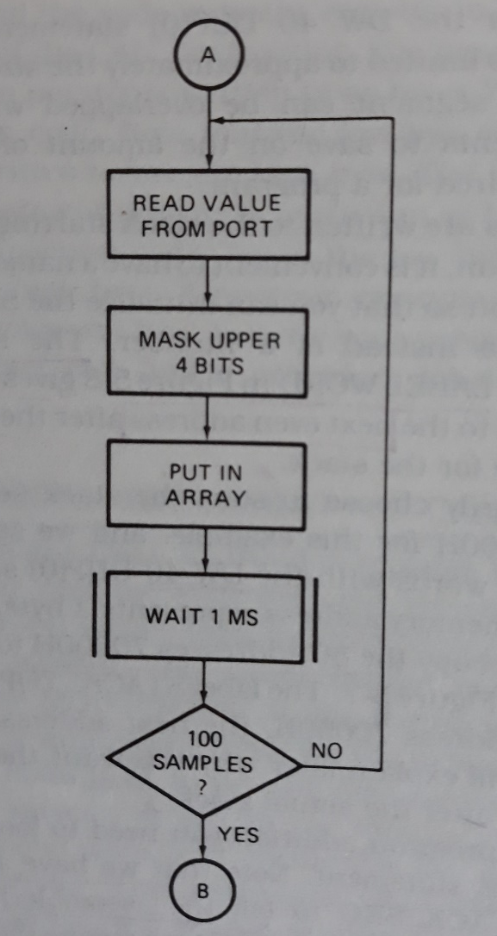
Procedure Examples (Cont.)
Read 100 samples of data at 1-ms interval

Slide 17
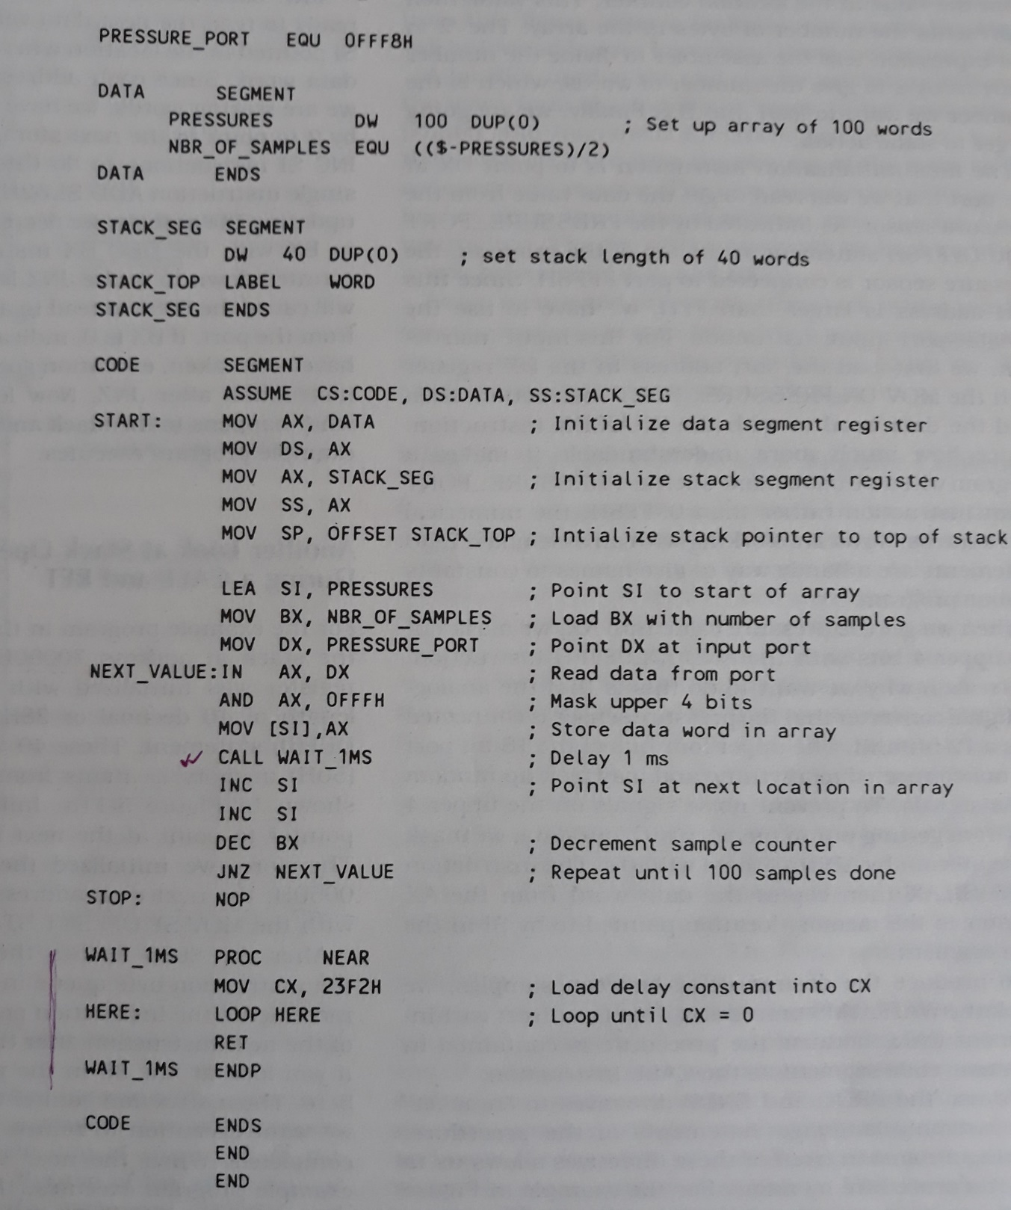
Procedure Examples (Cont.)
Read 100 samples of data at 1-ms interval (Cont.)

Slide 18
References
https://www.brainkart.com/article/memory-Stacks-in-8086-Microprocessor_7851/
https://faculty.kfupm.edu.sa/COE/shazli/coe205/Help/asm_tutorial_09.html#:~:text=there%20are%20two%20instructions%20that,bit%20value%20from%20the%20stack.&text=REG%3A%20AX%2C%20BX%2C%20CX,%2C%20SI%2C%20BP%2C%20SP
https://www.includehelp.com/embedded-system/procedures-in-the-8086-microprocessor.aspx
https://www.snjb.org/polytechnic/up-images/downloads/chapter%206-MAPupFile_058d4fa990abaa.pdf

